Slide 1
Chi-Squared Significance Tests
Example: Smoking Status and Lung Cancer
Suppose that you selected a sample of 500 people 25 years ago to study the possible effect of smoking on lung cancer.
Inference: Want to know what sample can tell us about population
Variables:
Smoker: Yes No
Contracted Lung Cancer: Yes No

Slide 2
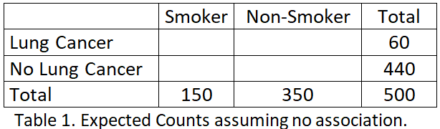
The Data
Suppose that out of the 500 people, 150 were smokers and 350 were not, and that 60 out of 500 people (12%) got lung cancer over the 25-year period.
Fill in a two-way table:

Slide 3
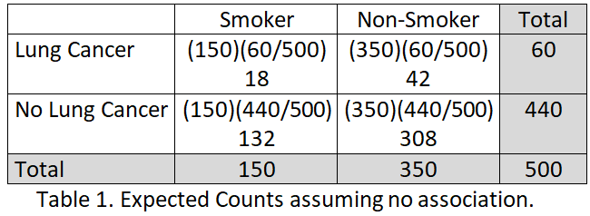

Assumption (Null Hypothesis H₀): No relationship Between Smoking and Lung Cancer

Slide 4
Chi-Square Significance Test
Test between two hypotheses.
Null hypothesis
H₀: There is no association between lung cancer and smoking.
Alternative hypothesis (researcher’s point of view)
H_{a}: There is an association between lung cancer and smoking.

Slide 5
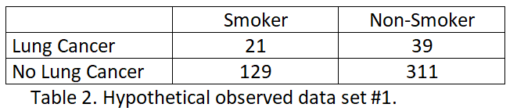
Hypothetical Data #1
If we collect “real-life” data, even if there really were no relationship between smoking and lung cancer, it is very unlikely we’d get the values in the “no relationship” table exactly. Instead, we might get a table something like Table 2:

Slide 6

Chi-Square Test Statistic
A chi-square test compares an “observed” cross-tabulated table (constructed from data) to the “no relationship” table. In order to conduct the test, you will calculate Pearson’s chi-square test statistic:
and a p-value. The p-value tells you the probability of obtaining a result equal to or more extreme than the value of the calculated chi-square statistic, assuming that the “no relationship” hypothesis is, in fact, true.

Slide 7
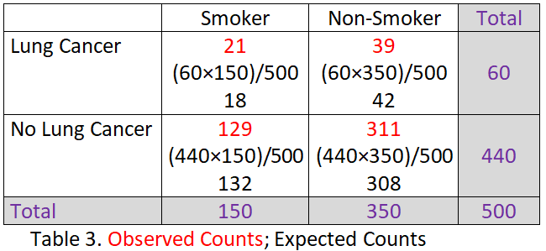

Calculating the Expected Counts Note: Data Totals and Expected Totals Match

Slide 8
Determining a p-value
If there is no relationship between the two variables, the chi-square statistic follows a
chi-square distribution with degrees of freedom = [(#rows – 1) × (#columns – 1)], which in this case is (2 – 1)(2 – 1) = 1.

Slide 9
Start with Population: 12% cancer rate No association with smoking Repeatedly select samples of size 500 Make two-way table Calculate chi-square test statistic
5.847
2.114
0.162
0.009
2.387
Keep repeating

Slide 10
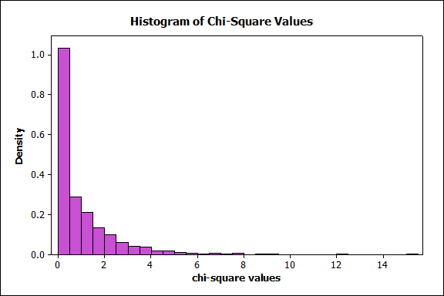
Graph of Chi-Square Density

Slide 11
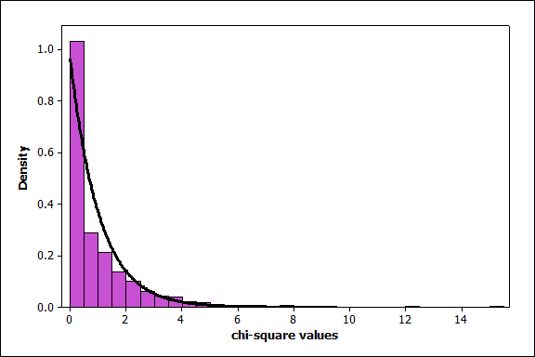
Graph of Chi-Square Density

Slide 12
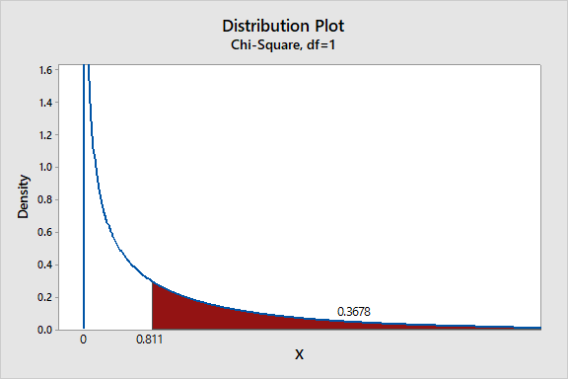
Determining a p-value (continued) Chi-square Density

Slide 13
Making a Decision
If p-value < 0.05, reject the null hypothesis in favor of the alternative.
Here p ≈ 0.3678. It is reasonably likely to observe a value from this distribution as or more extreme than the calculated chi-square value – it happens fairly frequently, roughly 37% of the time. (No conflict with null hypothesis.)
Conclusion: Insufficient evidence to reject the null hypothesis. (Data don’t appear at odds with null hypothesis.)

Slide 14
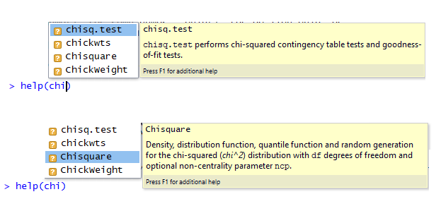
How do we do this in R?

Slide 15
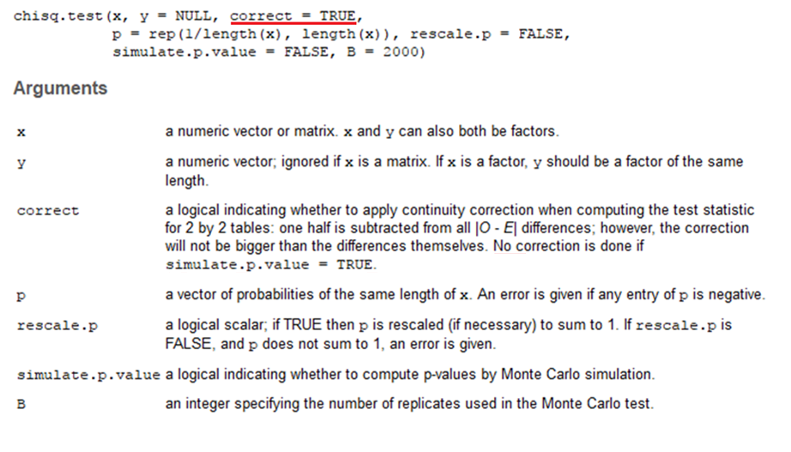

Slide 16




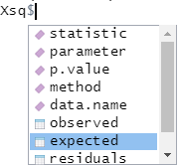

(M <- as.table(rbind(c(21,39), c(129,311))))
I put command above in ( ) so that the table
will print without my having to add M to the next
line of code.
(dimnames(M) <- list(Cancer_Status = c("Cancer", "No
Cancer"), Smoking_Status = c("Smoker", "Non-Smoker")))
(Xsq <- chisq.test(M)) # Applies Yates correction
(Xsq <- chisq.test(M, correct = FALSE))
Note: Xsq is a data frame.
Xsq$observed
Xsq$expected
Xsq$p.value
Xsq$statistic

Slide 17

Further Analysis
Explanatory variable: Smoking Status
Response variable: Cancer Status
We want the conditional distributions of Cancer Status for each level of Smoking Status, in this case, column proportions.
Options(digits = 4)
(M_Col_Perc <-prop.table(M,2))*100
barplot(M_Col_Perc, beside = TRUE,
xlab = "Smoking Status",ylab = “Percent",
ylim=c(0,110),
legend=rownames(M), col = c("coral", "coral3"))

Slide 18
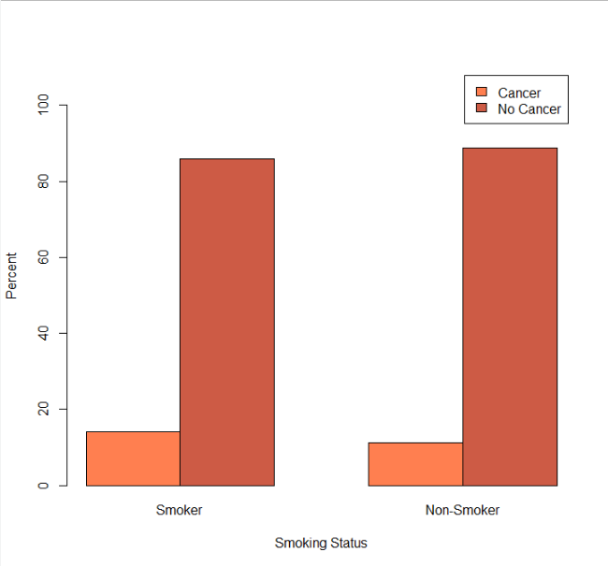
Barplot of Column Proportions (p ≈ 0.3678)

Slide 19
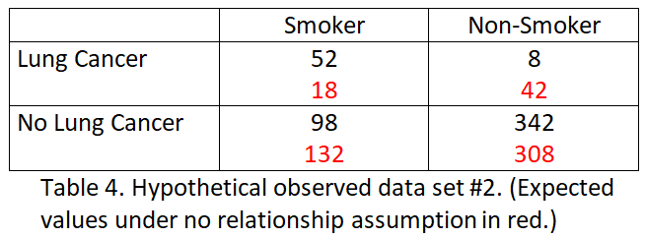
Hypothetical Data #2
The next hypothetical data set is more realistic, while still having the same row and column totals.
The data appear to be at odds with the expected counts. Next, we look at the chi-square test.

Slide 20

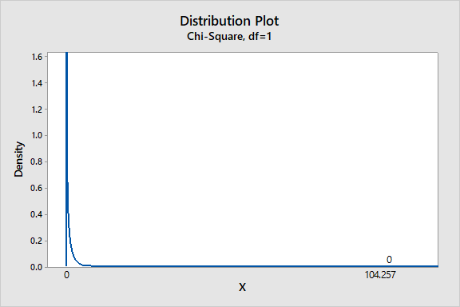
Chi-Square Test Statistic and p-value

Slide 21

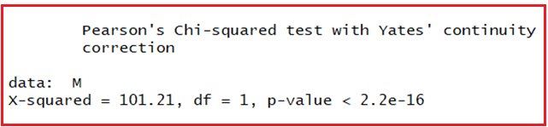
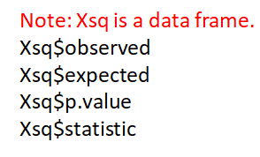
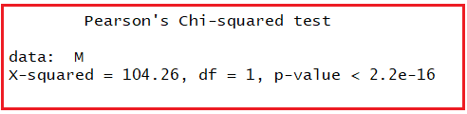
(M <- as.table(rbind(c(52,8), c(98,342))))
(dimnames(M) <- list(Cancer_Status = c("Cancer", "No Cancer"), Smoking_Status = c("Smoker", "Non-Smoker")))
(Xsq <- chisq.test(M)) # Applies Yates correction
(Xsq <- chisq.test(M, correct = FALSE))

Slide 22
Making a Decision
If p-value < 0.05, reject the null hypothesis in favor of the alternative.
Here p ≈ 0.000. It is highly unlikely to observe a value from this distribution as or more extreme than the calculated chi-square value – it pretty much never happens. (Totally in conflict with null hypothesis!)
Conclusion: Reject the null hypothesis in favor of the alternative. Conclude there is an association between smoking and lung cancer.

Slide 23
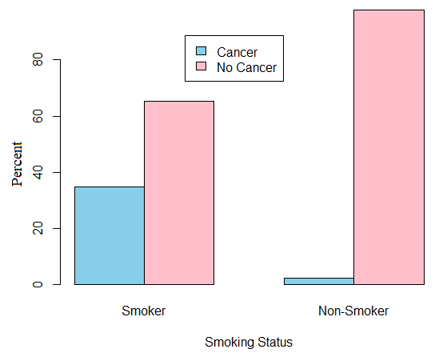

Slide 24
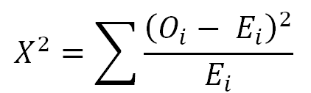
The Theory
Here’s the way the chi-square statistic works in theory. Suppose that we have a two-way table with r rows and c columns. What we do first is to compute the “no relationship” table as it is described previously. Label each cell in that table as E_{i}, for the “expected count.” Label the observed data value in each cell as O_{i}, for the “observed count.” We compute the following value:

Slide 25
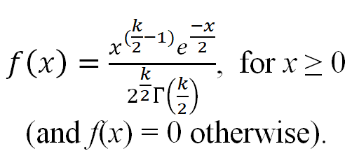
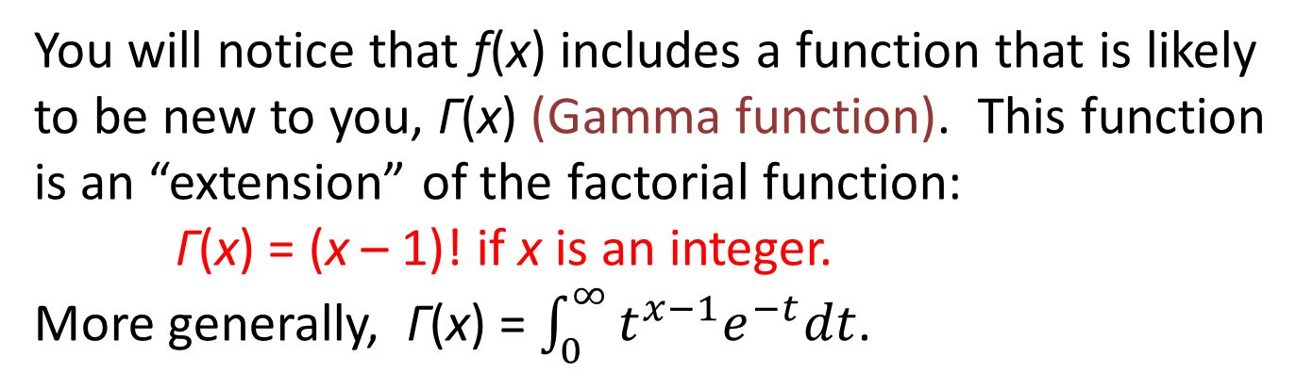
This value follows a chi-square (χ²) distribution with “degrees of freedom” equal to k = (r – 1) × (c – 1). This distribution has the following density function:
You will notice that f(x) includes a function that is likely to be new to you, Γ(x) (Gamma function). This function is an “extension” of the factorial function:
Γ(x) = (x – 1)! if x is an integer.
More generally, Γ(x) = $\int_{0}^{∞}{t^{x−1}e^{−t}dt}$.

Slide 26
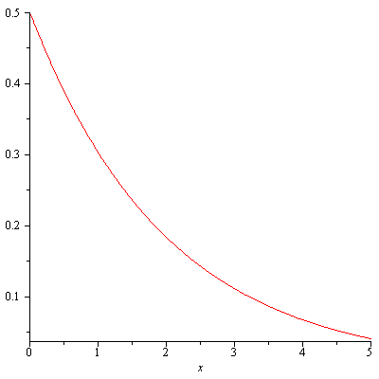
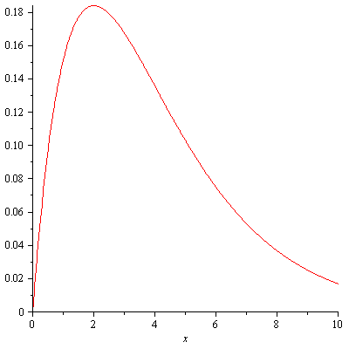
Graphs of Sample Chi-Square Density Functions
Degrees of Freedom
k = 2 k = 4

